Slide 1
Cognition
© R. KYES

Slide 2
Cognition
Relating to the mind and mental processes including:
learning, memory, perception, knowledge,
problem solving, thinking, etc.
Cognition is not an easy topic to study in animals because it often deals with unobservable processes –
(in the past many researchers suggested that cognition could not be studied for that reason).

Slide 3
Cognition
I. Focus on the process of Learning
Learning = a relatively permanent change in behavior due to experience.
- In the laboratory, learning (and memory) ability are often assessed as part of biomedical research studying the effects of aging, AIDS, menopause, drugs and alcohol on cognitive ability.
- In the wild, learning ability is critical for the primate’s survival. They need to learn how to find food, what foods are safe to eat, how to process the foods, which animals are predators, which group members are dominant and should be avoided, etc.

Slide 4
1) Insight Learning
A concept discussed by Kohler in the early 1900s.
He theorized that some primates learned to
solve problems by insight learning =
“sudden burst of knowledge.”

Slide 5
1) Insight Learning

Slide 6
1) Insight Learning
Today we know that animals do not solve problems by insight learning – rather, they need some experience with similar problems and may apply past experience to help solve new problems.

Slide 7
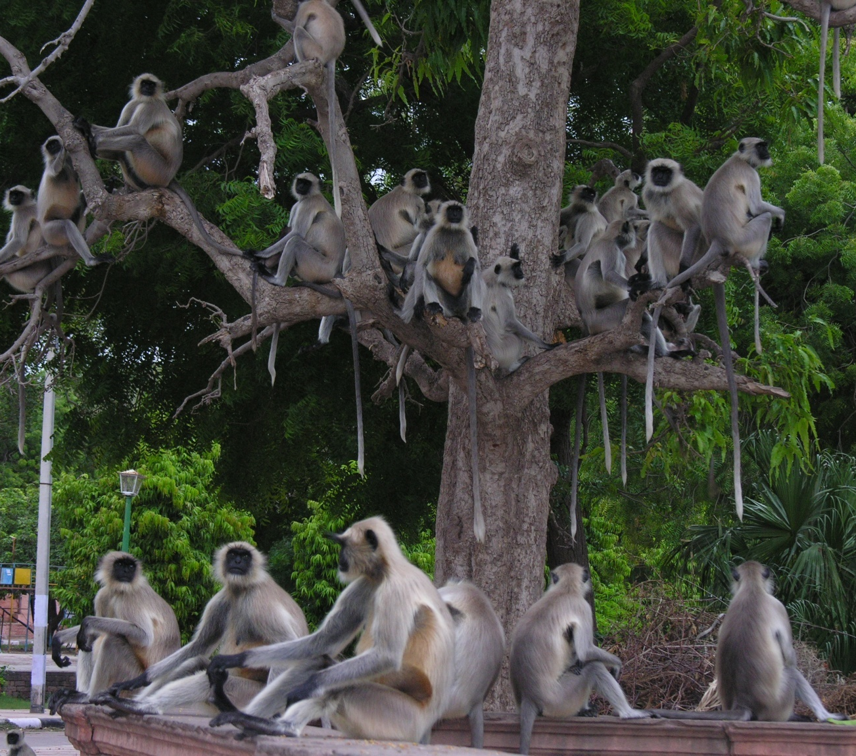
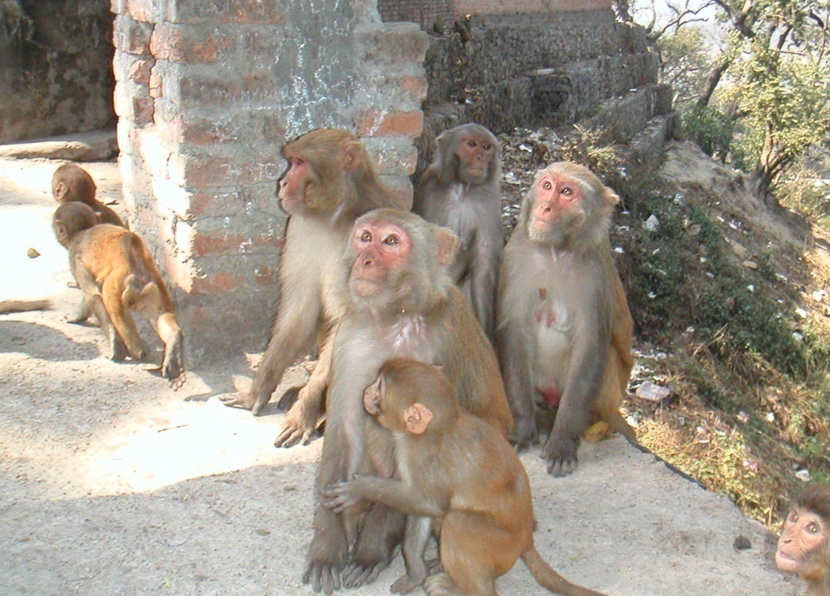
2) Observation/Social Learning
Animals learn by watching/observing other animals.

Slide 8
Example:
Young orangutans need a lot of experience to learn how to survive in the forest - how to build a nest, what foods to eat and how to process them, which animals are predators, etc. – they get that information from watching their mother.

Slide 9
2) Observation/Social Learning
Ex. Tool Use – use of an inanimate object to achieve some goal.

Slide 10
2) Observation/Social Learning
Ex. Tool Use
“Termite Fishing”

Slide 11
2) Observation/Social Learning
Ex. Tool Use

Slide 12
2) Observation/Social Learning
Ex. Tool Use

Slide 13
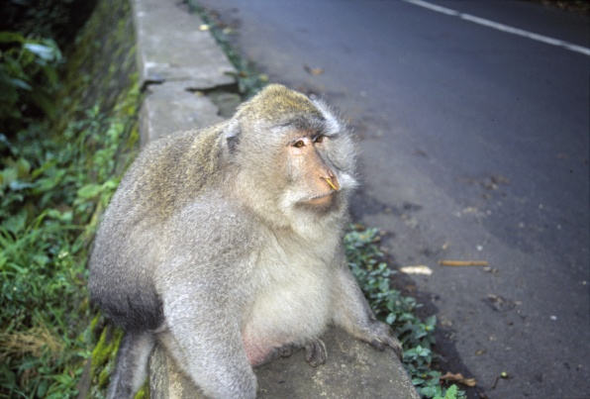
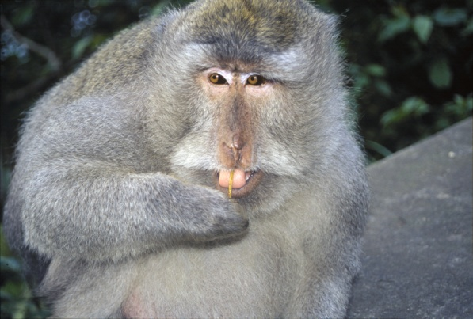
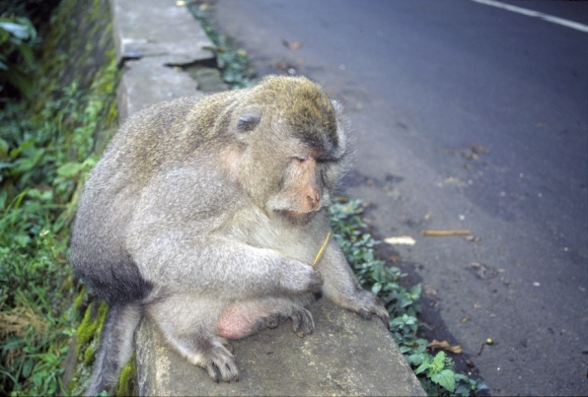
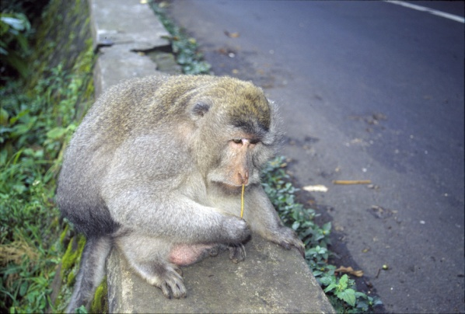
2) Observation/Social Learning
Ex. Tool Use

Slide 14
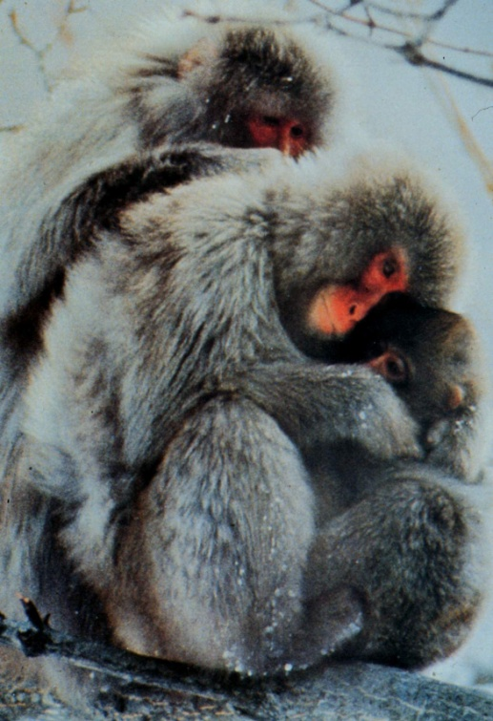
2) Observation/Social Learning
Ex. Tool Use
- Snow monkey potato washing – Koshima Island, “Imo”
- Capuchins using rocks to crack nuts
- Chimps using rocks to crack nuts
- Chimps throwing sticks/rocks as weapons

Slide 15
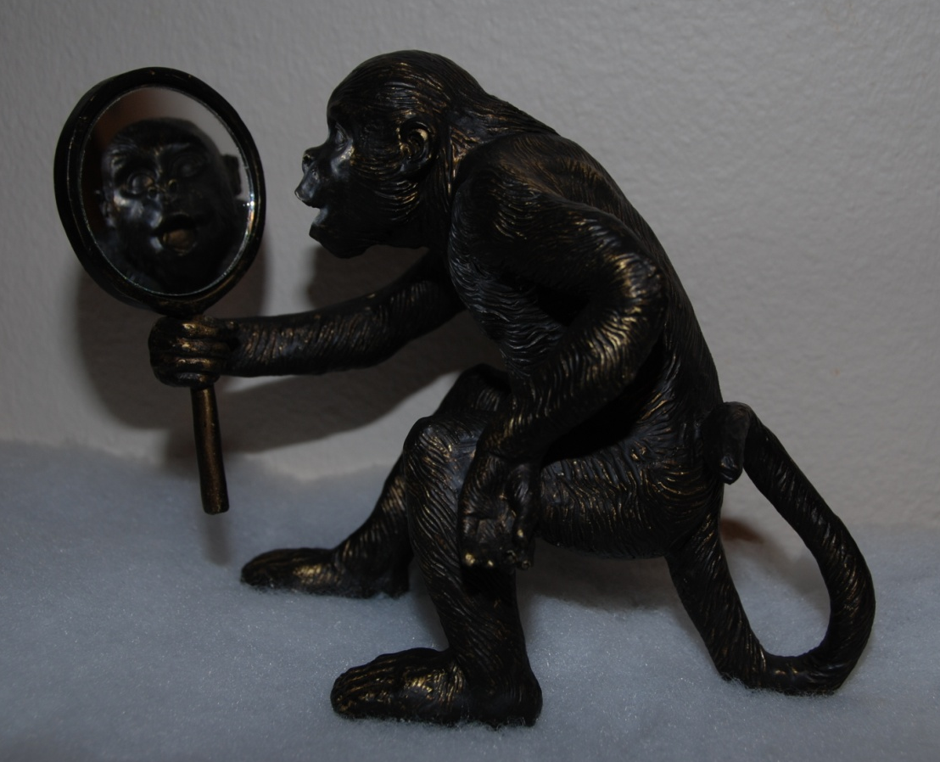
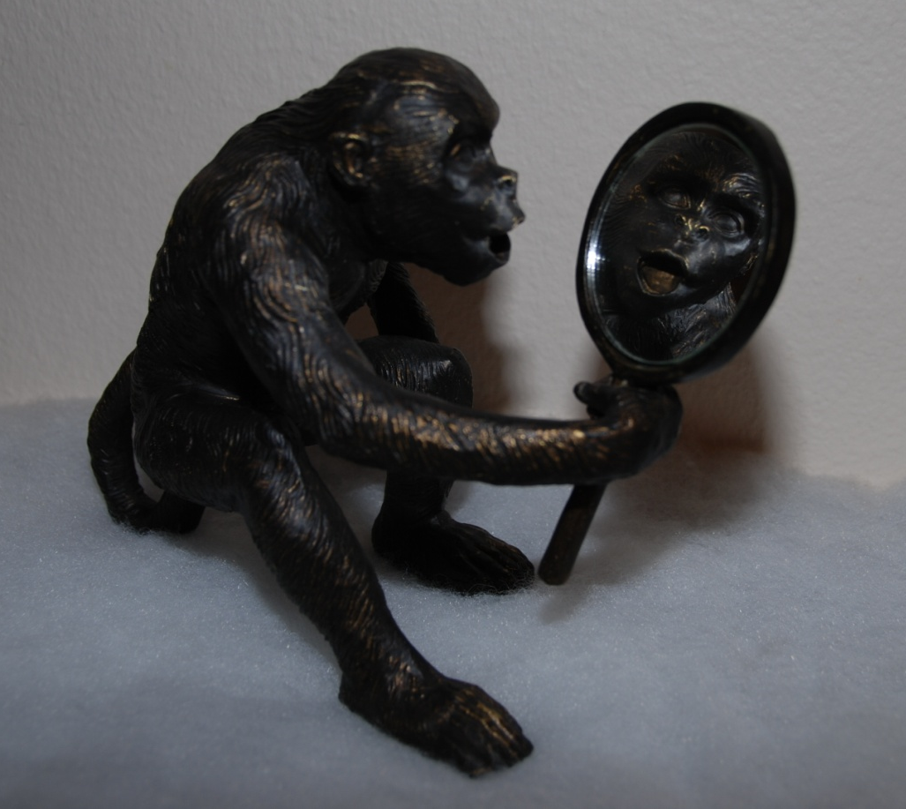
II. Self-awareness
Considered by many researchers to be the defining feature that separates humans from all other primates/animals.

Slide 16
Cognition
II. Self-awareness
Considered by many researchers to be the defining feature that separates humans from all other primates.

Slide 18
How do we determine if a primate has self-awareness?
In the 1970s, Gordon Gallup and colleagues designed a very simple but elegant procedure to assess self-awareness in primates.
His procedure was knows as the “Dye-mark test.”

Slide 19
Dye-mark test:

Slide 20
Dye-mark test:

Slide 21
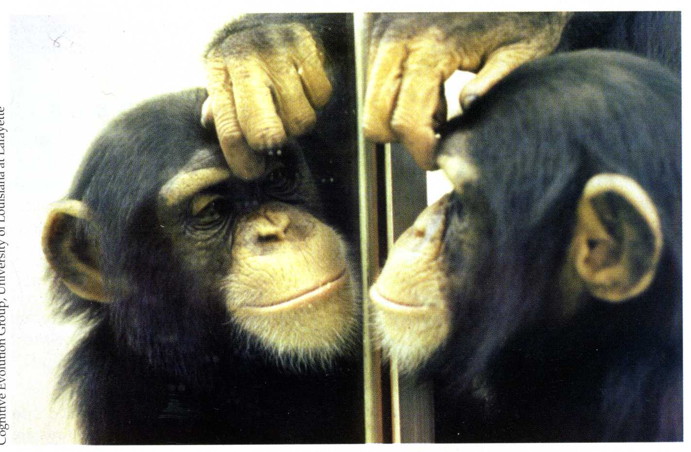
Dye-mark test:

Slide 22
Dye-mark test:
Results:
- The great apes (chimps, gorillas, orangutans) showed evidence of self-awareness.

Slide 23
Dye-mark test:
Results:
- All other primates species tested (several OWM species) failed to show evidence of self-awareness.

Slide 24
Self-awareness

